Slide 1
ATM Banking System
Team-1

Slide 2
Team Members - Contributions
Susmitha :
CRUD pages for customer and accounts
JWT integration
Frontend validations
Routes and navigation setup
Currency conversion
Added CSS
Integration with backend
Nikhil:
Created controllers and tested APIs
Created services to link controllers and repositories
Wrote backend logic for all use cases

Slide 3
Team Members - Contributions
Chirag:
Created repositories for database entities
Implemented authorization for all use cases
Created unit tests
Prachi:
UI of the application (CSS and Bootstrap)
Created react JS pages for transaction pages
Added validations and toasters
Integrated frontend with the backend.

Slide 4
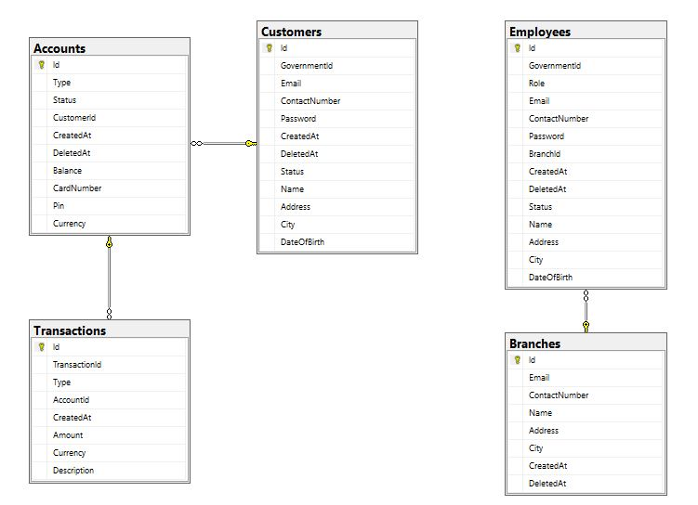
SQL Schema

Slide 5
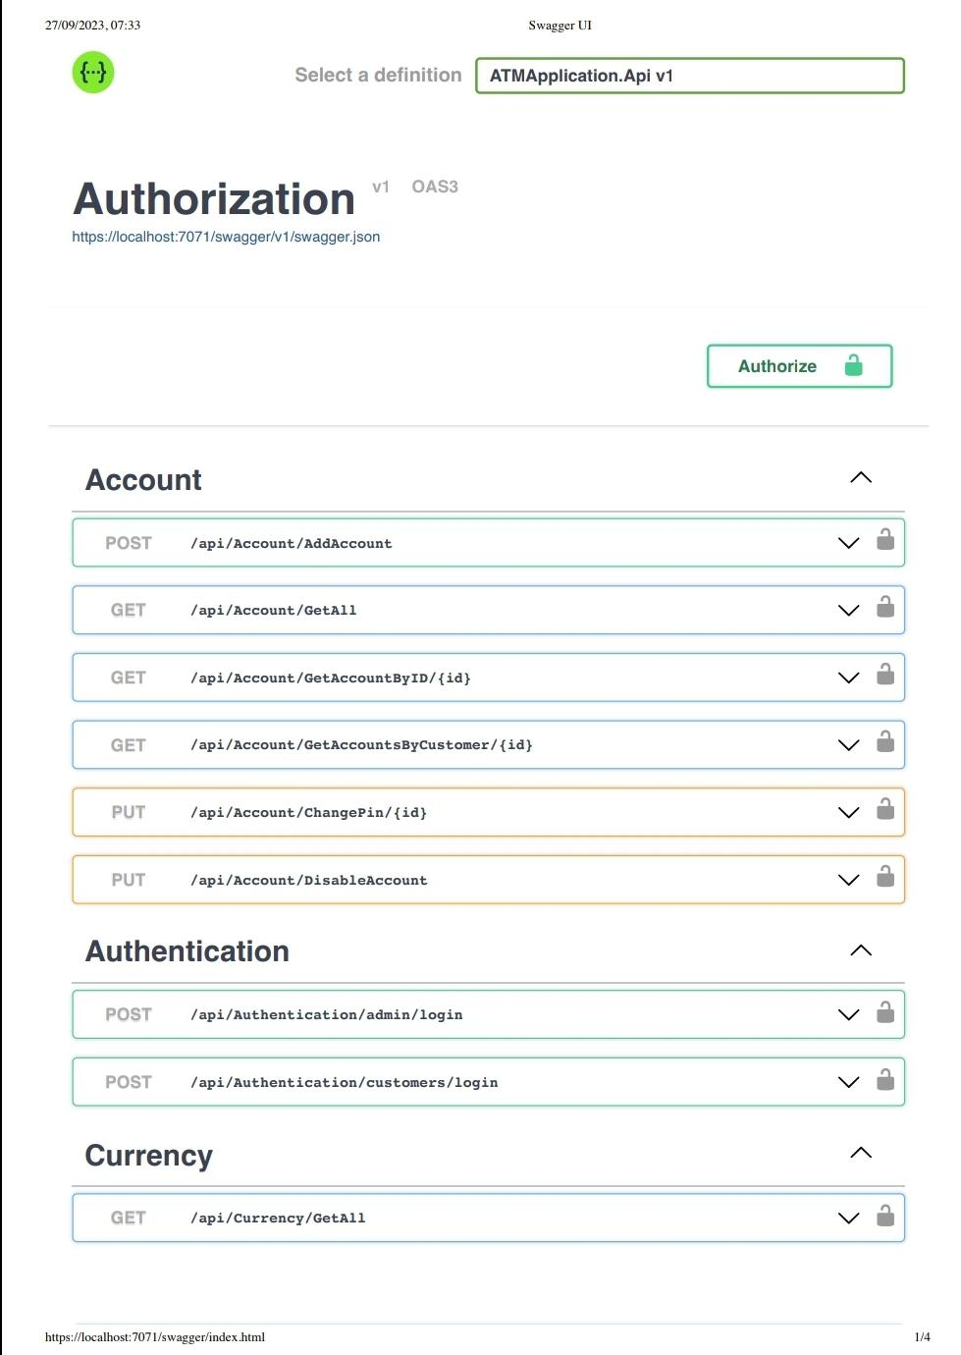
Swagger

Slide 6
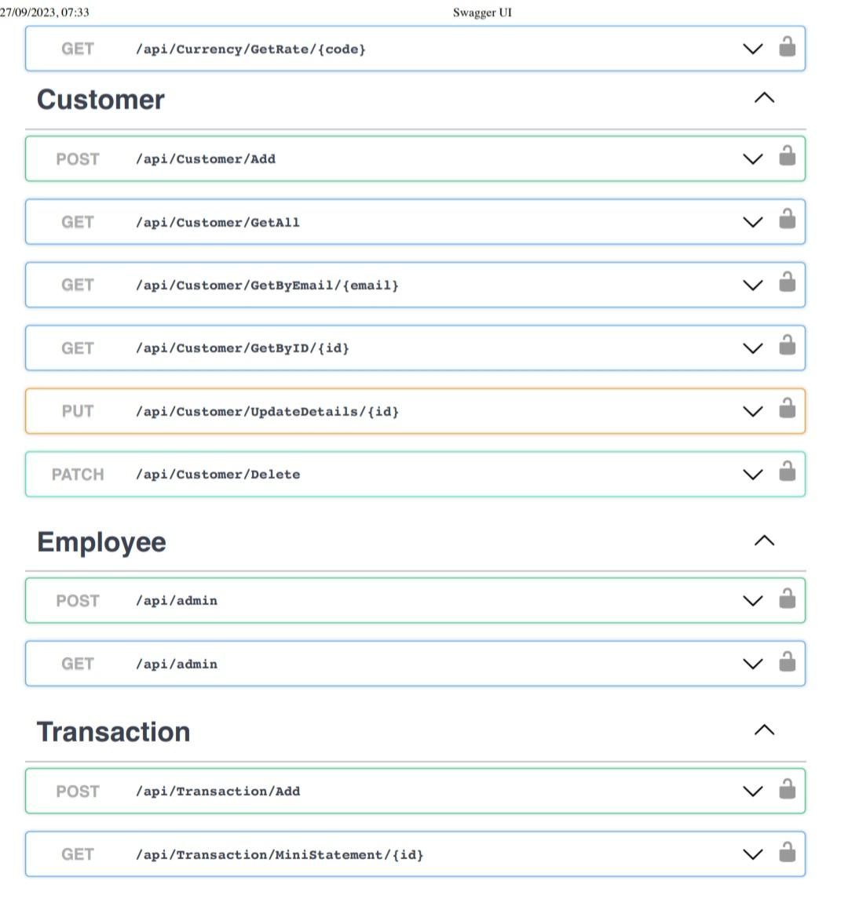
Swagger

Slide 7
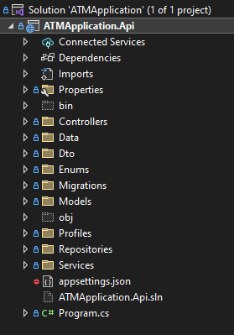
Project Structure

Slide 8
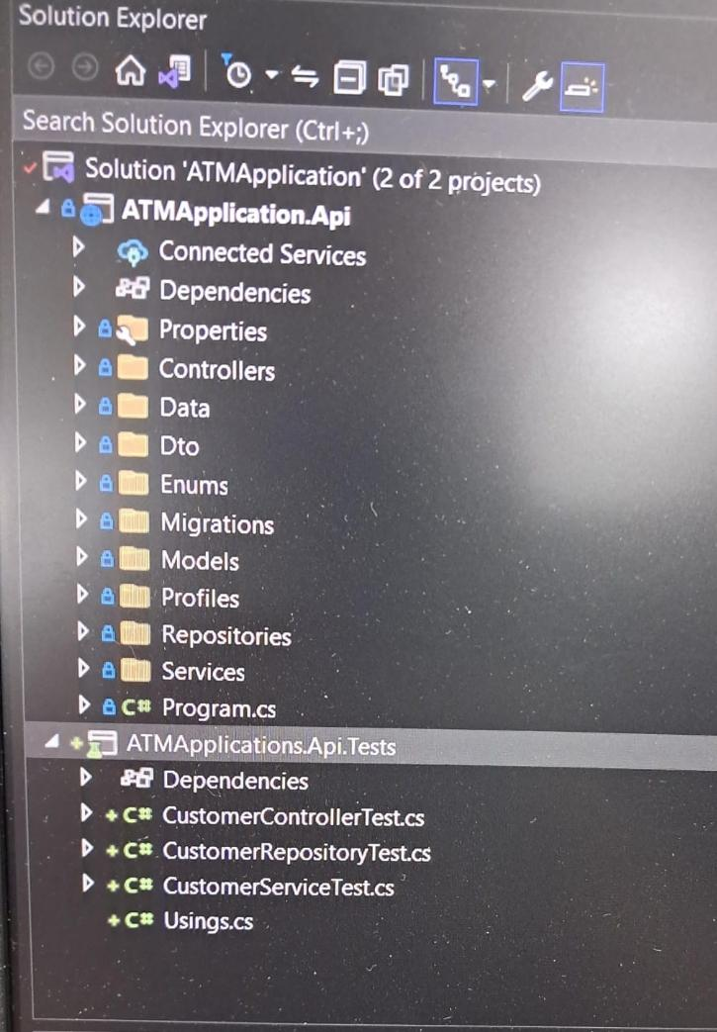
Unit Test Project Structure

Slide 9
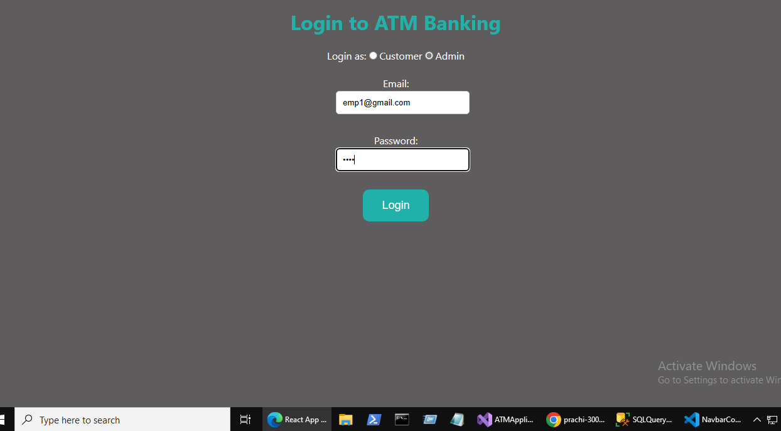
Login Page

Slide 10
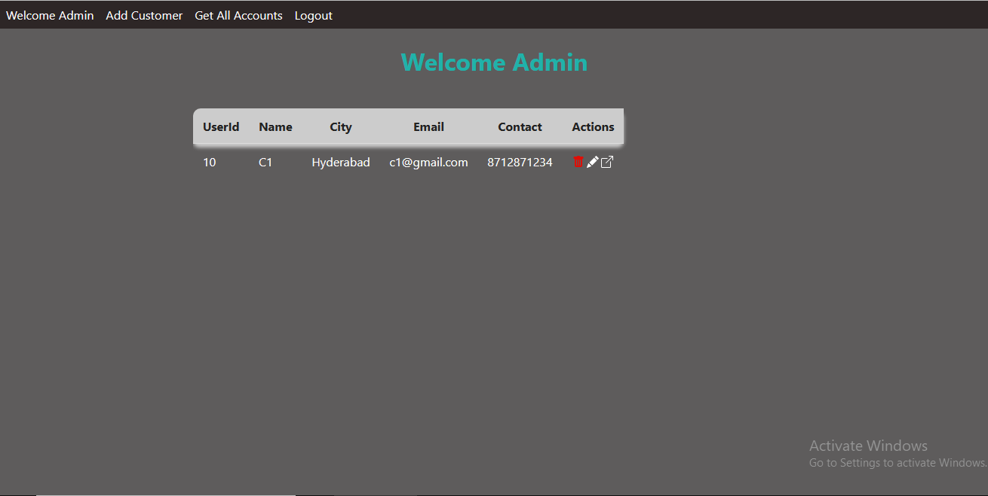
Landing Page for Admin

Slide 11
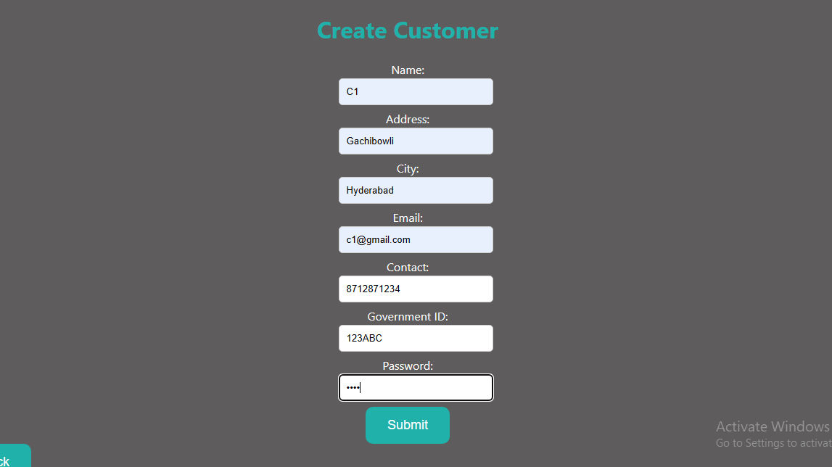
Add Customer Page

Slide 12
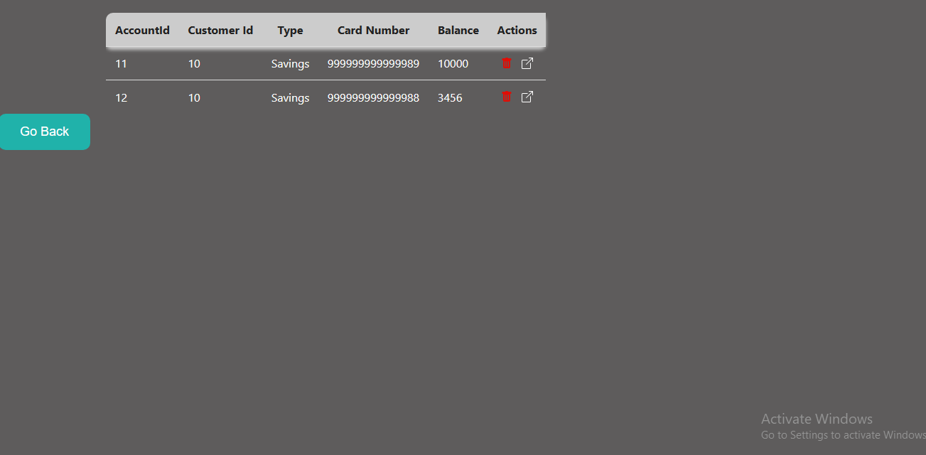
Get All Accounts Page

Slide 13
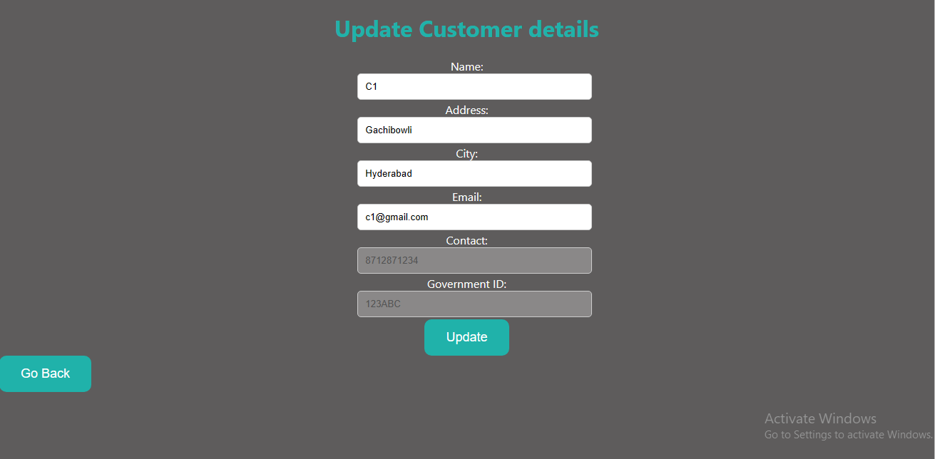
Update Customer Page

Slide 14
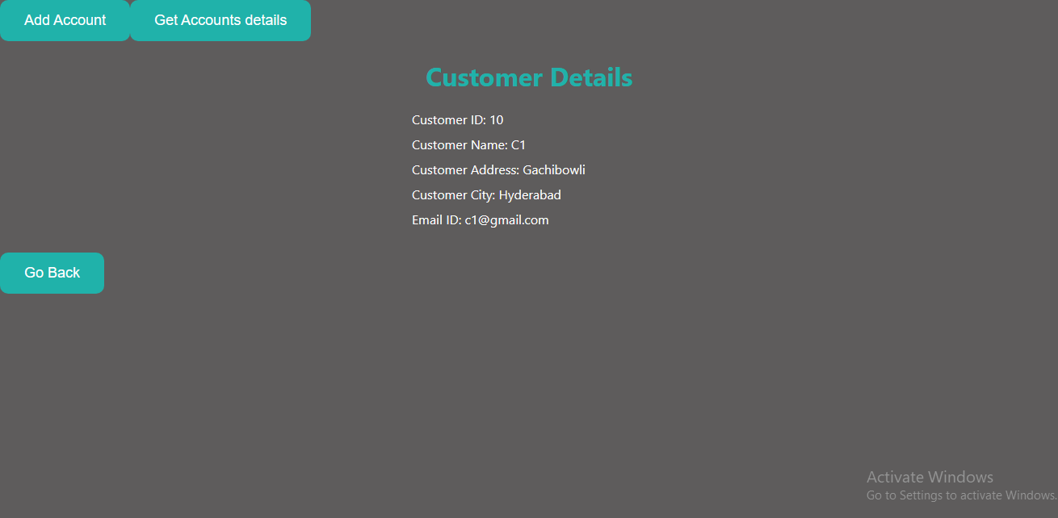
Get Customer Details

Slide 15
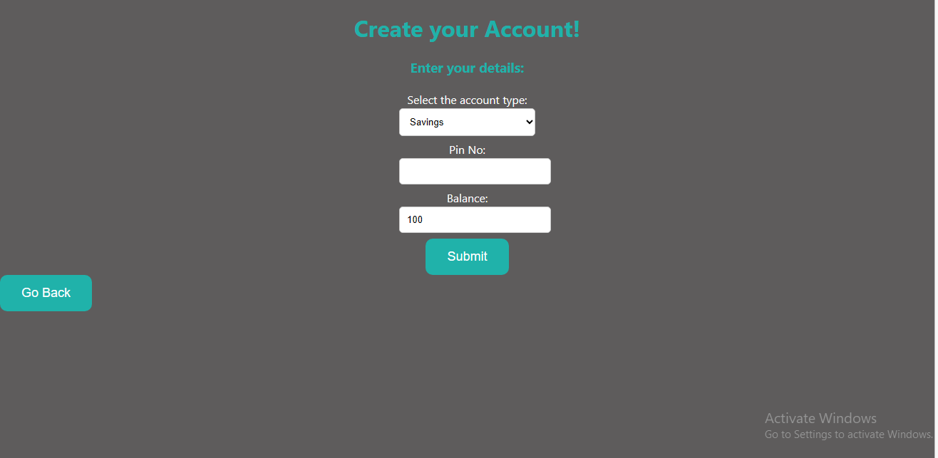
Add Account Page

Slide 16
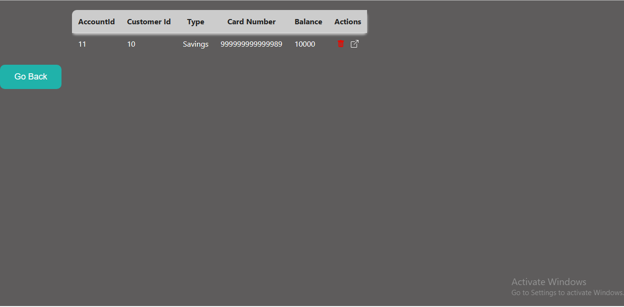
Get Accounts of Customer

Slide 17
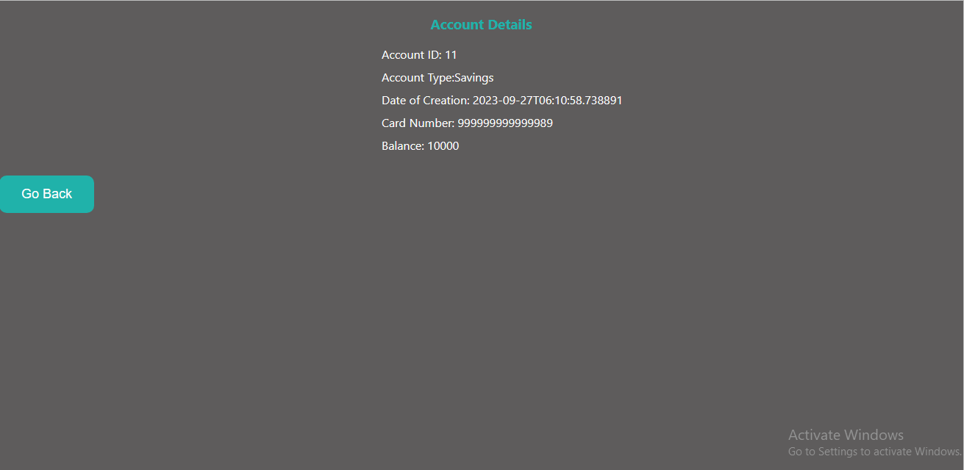
Get Account Details

Slide 18
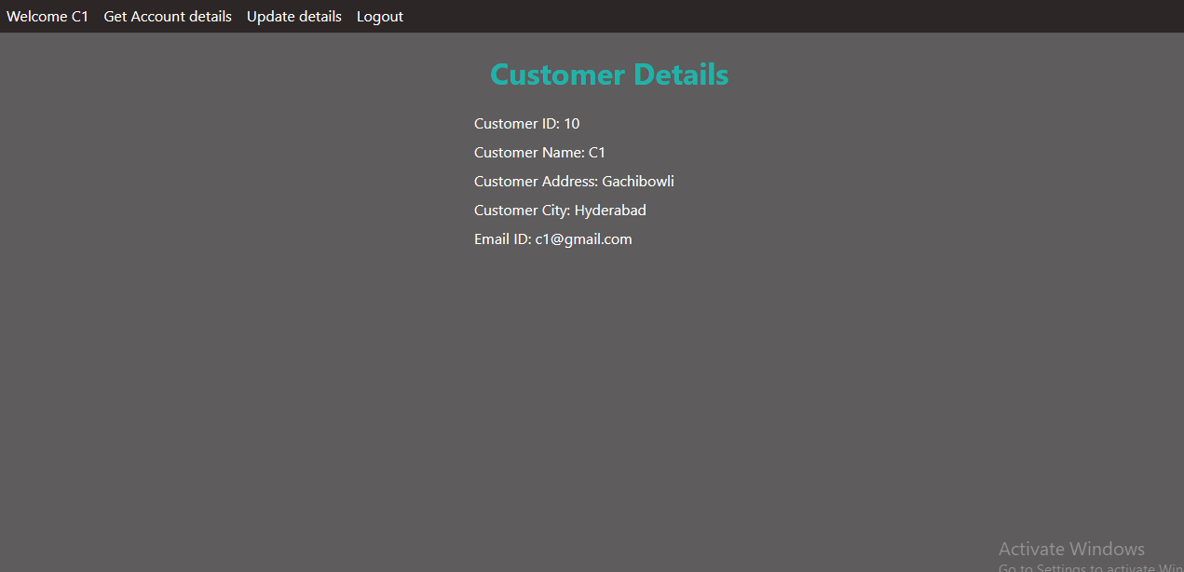
Landing Page for Customer

Slide 19
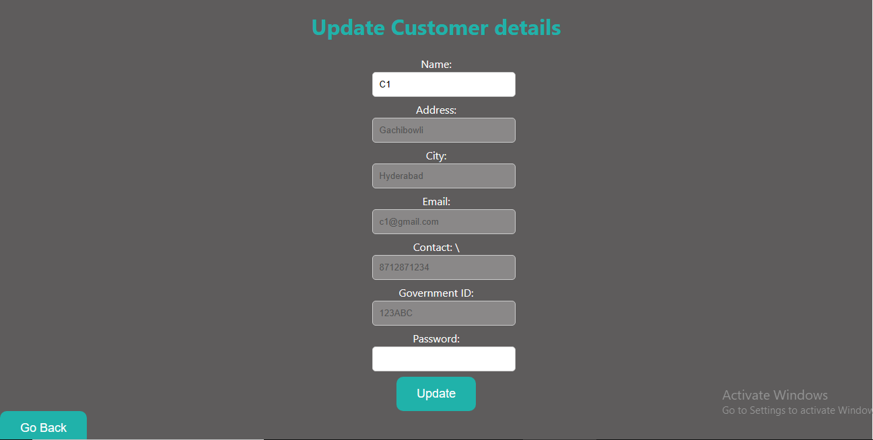
Update Credentials Page for Customer

Slide 20
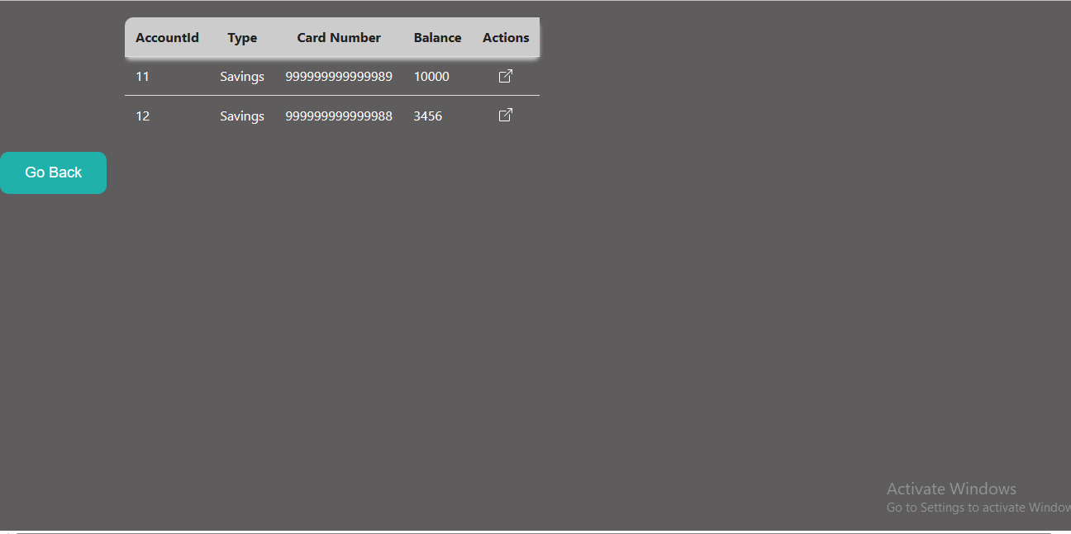
Get Account Details Page for Customer

Slide 21
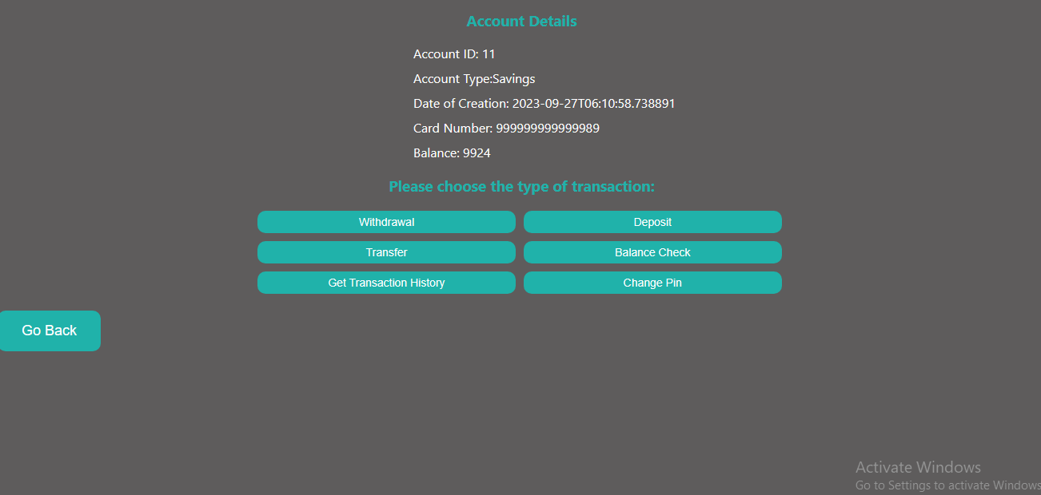
Account Details Page for Customer

Slide 22
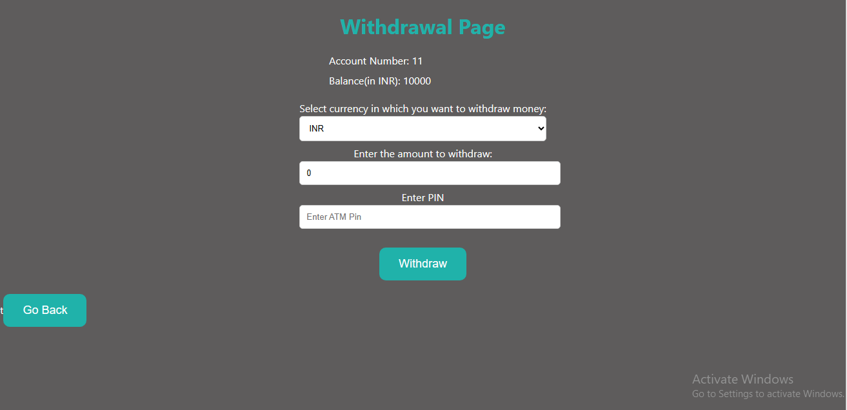
Withdrawal Page

Slide 23
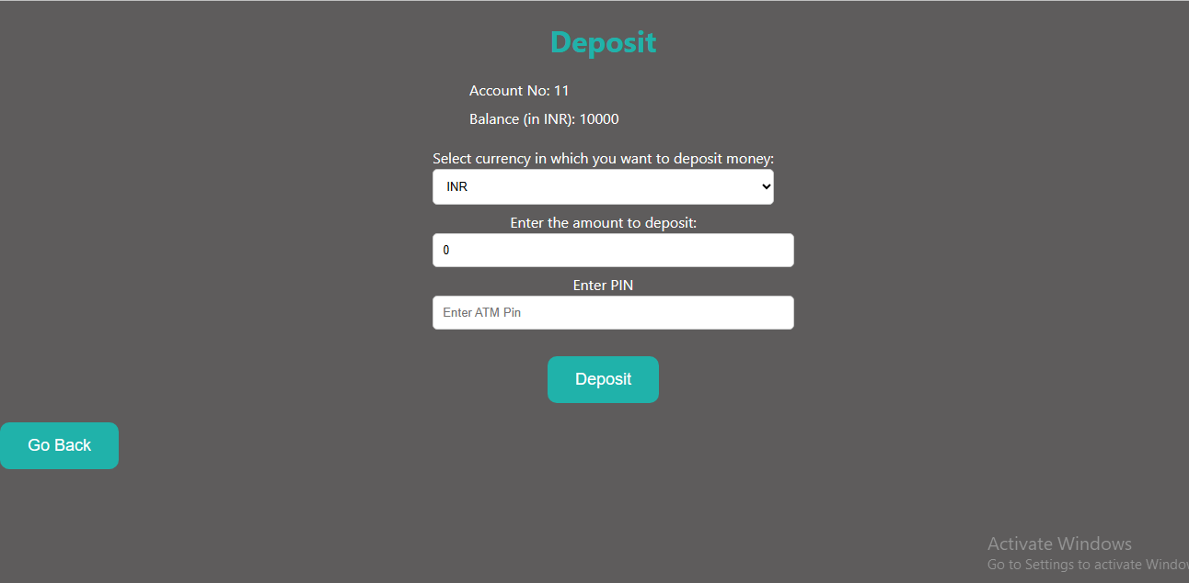
Deposit Page

Slide 24
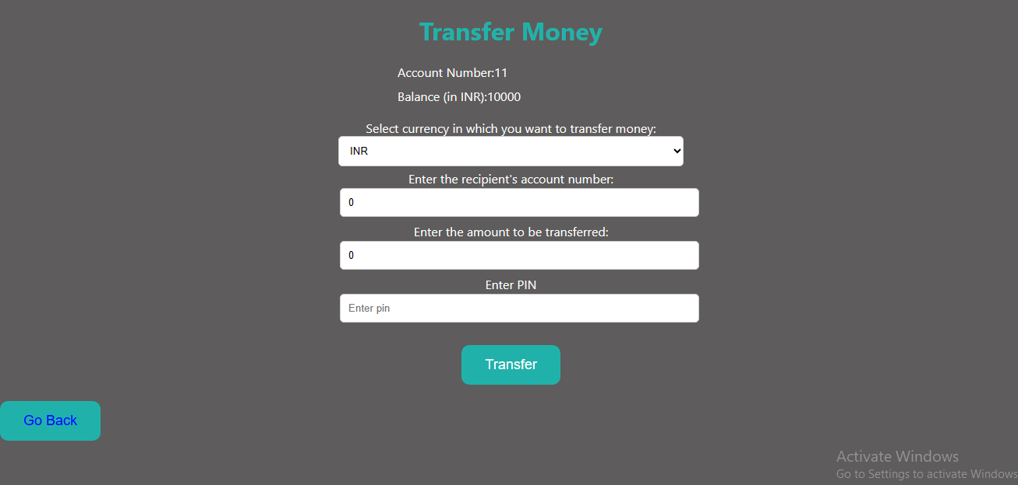
Transfer Page

Slide 25
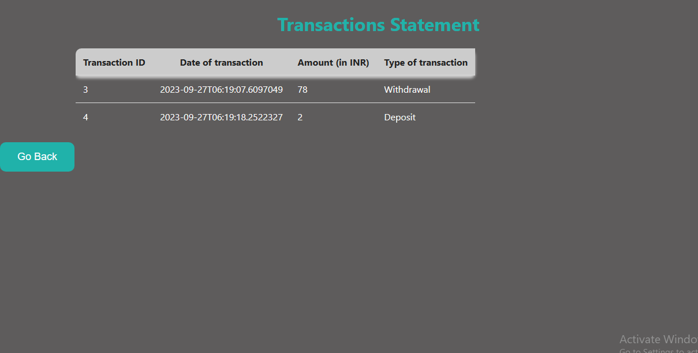
Mini Statements

Slide 26
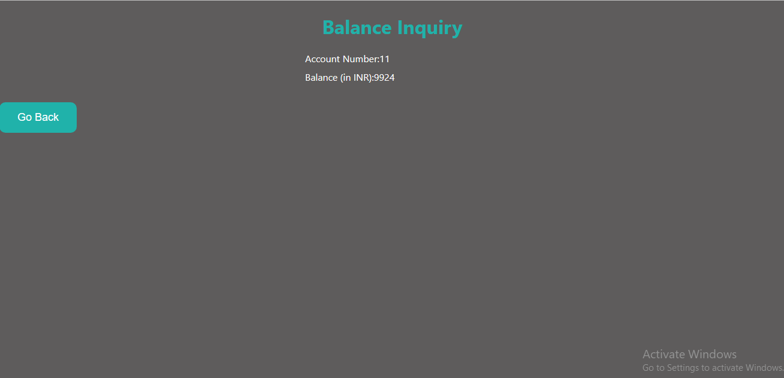
Balance Check

Slide 27

Change Pin

Slide 28
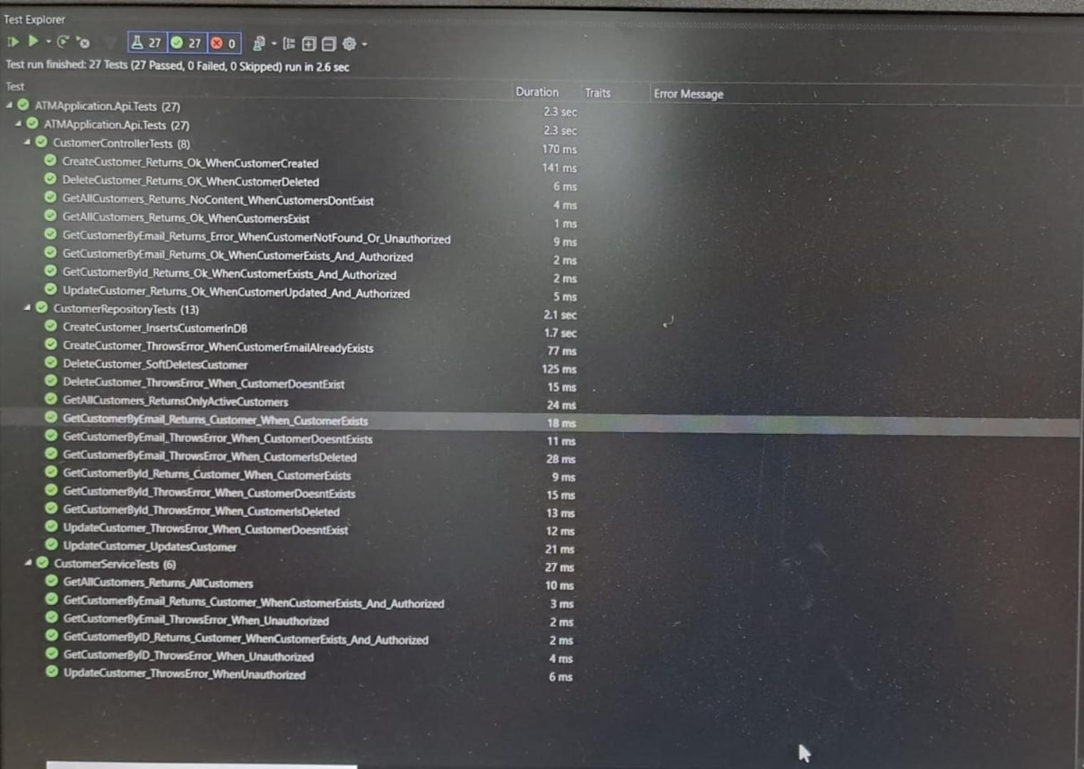
Test Explorer

